Slide 1

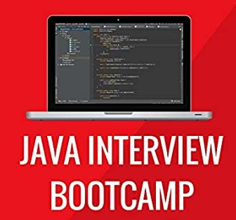
JAVA INTERVIEW BOOTCAMP
Lecture 1

Slide 2

Today’s Agenda
Objectives Of The Course
Prerequisites Of The Course
Why you should take this course ?
How this course is structured ?
Course Contents WalkThrough
Course Fee

Slide 3
Objectives
The ONE AND ONLY objective of this course is to enhance your CORE JAVA knowledge to such a level that you can excel in any JAVA BASED INTERVIEW.
Whether you are a fresher or highly experienced professional, CORE JAVA plays a vital role in any Java/JEE interview.
It is the favourite area in most of the interviews and plays a crucial role in deciding the outcome of your interview.

Slide 4
Objectives
This course comes directly from Team SCA’s 20+ years experience of Java programming and lots of interviewing experience.
We all know that recently Java 14 has been released and we have upgraded this course to include top questions from the latest releases as well.

Slide 5
Prerequisites
Since this course aims at preparing you for the Java Interview so you must be familiar with JSE i.e. CORE JAVA .
You must have written some code based upon the most basic Java topics like:
Java Fundamentals: Data Types ,Operators, Control Stmt
Arrays & String
Fundamentals Of Object Oriented Programming

Slide 6
Why You Should Take This Course?
This course aims at providing you 3 important benefits:
To deeply understand all the complex concepts in Java .
The course will make you CONFIDENT in your INTERVIEW because you will know that you can answer the question more accurately.
Most importantly , if you are planning to go for our JAVA PROJECT Batch or JAVA FRAMEWORKS Batch then this course will lay the foundation for them too.

Slide 7
How The Course Is Structured ?
The course is structured in such a way that it will:
Refresh your Java concepts
Fill the gaps in most crucial Java topics like OOP Concepts, Interfaces, Run Time Polymorphism, Collections ,Generics , Strings etc.
Apart from covering the CORE topics of JAVA , we will also cover the most important new features introduced from Java 7 to Java 14.

Slide 8
Course WalkThrough
There’s lot we will cover in this course and so it has been divided into 11 modules:
Module 1 : Java Basics
Module 2: Object class, Wrapper Classes & Inner Classes
Module 3: Arrays & Strings With Advance Concepts
Module 4: OOP In Depth With Advance Concepts
Module 5: Exception Handling With Enhanced Features
Module 6: Collections And Generics With Advance Concepts
Module 7: New & Important Features From Java 7 to Java 14
Module 8: JVM Architecture , Memory Areas & Garbage Collection
Module 9: Multithreading
Module 10: Design Patterns
Module 11: Most Frequently Asked Programming Puzzles

Slide 9
Module 1: Java Basics
Platform Independency V/s Portability
Comparison Between JDK , JRE , JVM and JIT
The main() Method And It’s Variants
Data Types,Operators & Precedence
instanceOf Operator
Tricky Questions Based On Above Topics

Slide 10
Sample Questions We Will Discuss In The Class
Guess The Output :
byte b = 5;
b=-b;
System.out.println(b);
Output:
Error
Guess The Output:
byte b = 5;
b+=10;
System.out.println(b);
Output:
15

Slide 11
Sample Questions We Will Discuss In The Class
Guess The Output:
int a=0;
for(int i=0;i<100;i++)
{
a=a++;
}
System.out.println(a);
Output:
0

Slide 12
Sample Questions We Will Discuss In The Class
Check whether number is even or not without any Arithmetic Operator
Solution:
if((number & 1) == 0){
System.out.println("Even number");
}

Slide 13
Module 2 Object , Wrapper & Inner Class
Object class
Wrapper class
AutoBoxing & UnBoxing
Inner Class
Types Of Inner Classes
Tricky Questions Based On Above Topics

Slide 14
Sample Questions We Will Discuss In The Class
Guess The Output:
Integer b2=127;
Integer b3=127;
System.out.println(b2==b3);
Output:
true
Guess The Output:
Integer b2=128;
Integer b3=128;
System.out.println(b2==b3);
Output:
false

Slide 15
Module 3: Arrays And String
Introduction To Array
One Dimensional Array
Creating , Initializing, Accessing
Multi Dimensional Array
Creating , Initializing, Accessing
Tricky Questions Based On Above Topics

Slide 16
Sample Questions We Will Discuss In The Class
Guess The Output:
int []arr=new int[5];
System.out.println
(arr.getClass().getName());
Answer:
[I
Guess The Output:
int[]arr={10,20};
int []brr={10,20}; System.out.println
(arr.equals(brr));
Output:
false

Slide 17
Module 3: Arrays And String
Introduction To String & It’s Important Methods
Understanding String Constant Pool
Strings Immutability
Benefits Of Immutability
Comparison With StringBuffer And StringBuilder
Tricky Questions Based On Above Topics

Slide 18
Sample Questions We Will Discuss In The Class
Guess The Output:
String s=new String(“Hello”);
How many objects are created in the above code ?
Answer:
2
Very Popular Question:
Why it is not recommended to use Strings for storing passwords ?

Slide 19
Module 4: OOP & Advance OOP
Encapsulation
Abstraction
IS-A RelationShip
HAS-A RelationShip
super(), this() & toString()
Tricky Questions Based On Above Topics

Slide 20
Sample Questions We Will Discuss In The Class
Can we instantiate a class in this way ?:
public class A
{
A a = new A();
}
Answer:
Not possible, Because while instantiating, constructor will be called recursively.
Very Popular Interview Question:
Why it is not recommended to use Strings for storing passwords ?

Slide 21
Module 4: OOP & Advance OOP
Polymorphism( Signature , Overloading & Overriding)
Cohesion & Coupling
Abstract Class
Interface
Packages , Access Modifiers And Non Access Modifiers
Tricky Questions Based On Above Topics

Slide 22
Module 5: Exception Handling
Exceptions V/s Errors
Combinations Of try,catch,finally
Throw and Throws
Checked V/s UnChecked Exceptions
MultiCatch , Try With Resources
Best Practices

Slide 23
Module 6: Collections & Generics
Introduction To Collection Framework
List & ArrayList
ArrayList V/s Vector
For V/s Enhanced For V/s Iterator V/s ListIterator
Which traversal should be preferred when ?
Set , HashSet & TreeSet

Slide 24
Sample Questions We Will Discuss In The Class
Very Popular Interview Question:
Why it is recommended to use
List list = new ArrayList();
instead of
ArrayList list = new ArrayList();

Slide 25
Module 6: Collections & Generics
Comparator V/s Comparable
Map , HashMap & TreeMap
Internal Working Of HashMap
Changes In HashMap In Java 8
HashMap V/s Hashtable
Tricky Questions Based On Above Topics

Slide 26
Module 6: Collections & Generics
Generic needs - Generic Types
Raw type, Multiple type parameter, Subtyping
Generic Methods
Bounded Type | Type inference
Wild Cards | Bounded wild cards
Tricky Questions Based On Above Topics

Slide 27
Module 7: Java 7 To Java 14 –New Features
New Features Introduced By Java 7
Multi Catch
Try With Resources
Diamond Operator
String In Switch
Tricky Questions Based On Above Topics

Slide 28
Module 7: Java 7 To Java 14 –New Features
What Is Modern Java , LTS & STS ?
Why Java 8 Is So Popular ?
New Features Of Java 8
Java 8 Interface Enhancements
Lambda Expressions
Tricky Questions Based On Above Topics

Slide 29
Module 7: Java 7 To Java 14 –New Features
Functional Interfaces
Lambdas & Collections
Predefined Functional Interfaces
Method References
The forEach() Method
The Stream API

Slide 30
Module 7: Java 7 To Java 14 –New Features
New Features Of Java 9
Jshell
Private methods in interface
New Features Of Java 10
var keyword
New Features Of Java 11
String API Updates
Running Code Without Compiling

Slide 31
Module 7: Java 8 To Java 14 –New Features
New Features Of Java 12
Extended Switch (freedom from break)
New Features Of Java 13 & 14
Text blocks
Enhancements In switch
Helpful NullPointerException
Record

Slide 32
Module 8: JVM Architecture,Memory Areas & Garbage Collection
JVM Introduction
ClassLoaders
Memory Areas
Execution Engine
Garbage Collection
Tricky Questions Based On Above Topics

Slide 33
Sample Questions We Will Discuss In The Class
Very Popular Interview Question:
Why we should never use finalize() method ?

Slide 34
Module 9: MultiThreading
What Is MultiThreading And Why We Need It ?
Why Companies Ask MultiThreading ?
Creating Threads
Thread Life Cycle
InterThread Communication
Synchronization

Slide 35
Module 10: Design Patterns
What Are Design Patterns ?
Why Companies Ask Design Patterns ?
Singleton Design Pattern
Factory Design Pattern
MVC Design Pattern
Tricky Questions Based On Above Topics

Slide 36
Module 11: Java Programming Puzzles
Most Commonly Asked Programming Puzzles
Swap 2 Strings Without Using Third String Or Array
How to Find all Pairs in Array of Integers Whose sum is Equal to a Given Number ? ( Appeared in Amazon , Facebook & Microsoft)
Check Whether Two Strings Are Anagram Or Not
And Many More. . .

Slide 37
The Final Deliverables
Based upon what you learn during the progress of the course we will deliver the following:
Complete Notes
Discuss 300+ Interview Questions.
Walk through code samples and solve quizzes.
Have hands on and active learning
Regular tests to monitor your understanding of the course.

Slide 38
Course Duration & Schedule
Item | Dscription
Course Duration | 45 days
Batch Schedule | Monday, Wednesday , Friday
Batch Timings | 5 PM
Class Duration | 1.5 Hours
Next Class | Wednesday 29th July

Slide 39
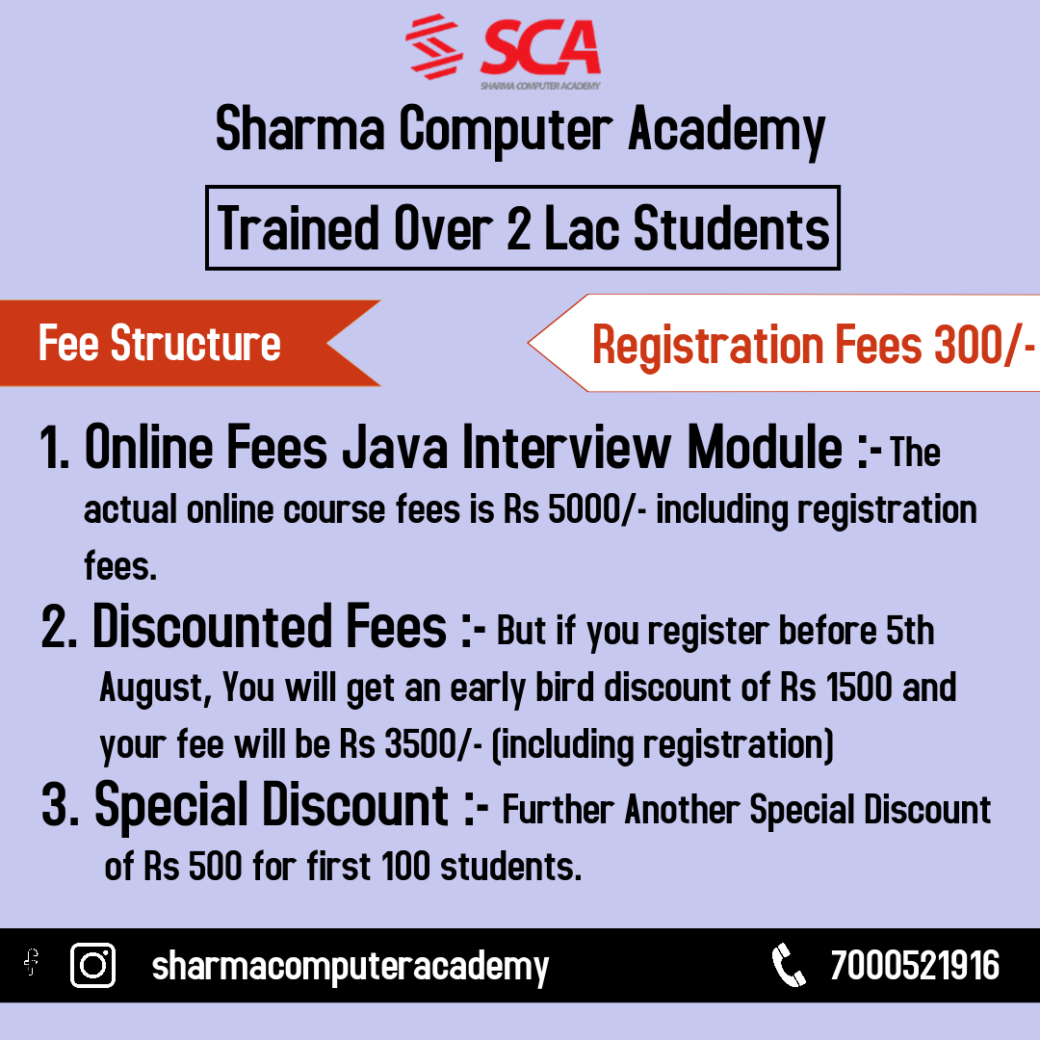
Course Fee

